Slide 1
«Scientists who changed the world»
Isaak Konstantinovich Kikoin

Slide 2
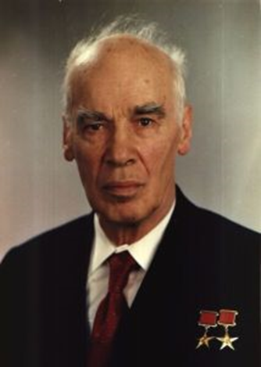


Slide 3
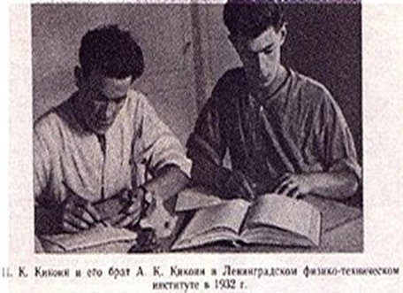

Slide 4

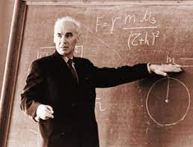
In 1930-1931 Isaak Kikoin studied photomagnetism and his early work investigated the electrical conductivity and magnetic attractions in metals. In 1933 Kikoin and Noskov discovered a new phenomenon – photomagnetic effect in semiconductors, which now is called “Kikoin-Noskov effect”. Isaak Kikoin became the Doctor Nauk in 1935. He taught physics at the Leningrad Polytechnic Institute and later, in 1938-1944 at the Ural Polytechnic Institute.
Notes:
Наиболее значимые мотивы отношения к физической культуре
4

Slide 5
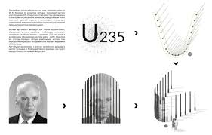

Slide 6
Isaak Konstantinovich Kikoin was awarded the Stalin Prize four times in 1942, 1949, 1951, 1953, the Lenin Prize in 1959, and the USSR State Prize in 1967 and 1980. Kikoin was named a Hero of Socialist Labour in 1951, he also won the Kurchatov Medal in 1971. In 1974 Kikoin was awarded the title of “Honorary Freeman of Novouralsk”.

